Slide 1
Parameterised turbine performance
Power Curve Working Group – Glasgow, 16 December 2014
Stuart Baylis, Matthew Colls, Przemek Marek, Alex Head

Slide 2
Site specific performance
A calculated power curve is calculated in a particular set of conditions (shear, turbulence etc.).
We can ask two questions:
In matching conditions, do measurements agree?
How does performance change outside these conditions?
Today we will focus on answering the second question.

Slide 3
Aim
To aggregate turbine performance data into a parameterised model:
A single model applicable globally
Spanning variations in geometry of turbines
Across all site conditions
Parameters must capture physical drivers of performance variation
Rotor aerodynamics
Controller influence
To be used to predict turbine performance with pre-construction mast data.

Slide 4
Current practice
(data for illustrative purposes)
Various methods in use
Theoretical or data-derived
Often parameterised
Fixed adjustment
Shear
Turbulence
Wind speed
Geometry
Turbine type
Geography
Density
2D binning misses significant performance variation
Wind speed/turbulence
 | 4 |  | 6 |  | 8 |  | 10 |  | 12
24% | 120% | 112% | 108% | 106% | 102% | 102% | 99%
 | 116% | 109% | 106% | 104% | 104% | 102% | 101% | 100% | 96% | 97%
16% | 111% | 105% | 101% | 101% | 101% | 102% | 101% | 100% | 99% | 99%
 | 99% | 96% | 96% | 98% | 99% | 101% | 101% | 101% | 100% | 100%
8% | 82% | 88% | 89% | 92% | 95% | 98% | 100% | 101% | 102% | 101%
 | 75% | 82% | 83% | 87% | 88% | 93% | 97% | 99% | 101% | 100%
0% | 62% | 70% | 76% | 78% | 81% | 84% | 88% | 94% | 100% | 101%
Shear/turbulence at 6 m/s
 | -0.2 |  | 0.0 |  | 0.2 |  | 0.4 |  |  | 0.6
24% | 92% | 100% | 117% | 112% | 109% | 102%
 | 89% | 98% | 110% | 106% | 110% | 97% | 96% | 95%
16% | 94% | 95% | 103% | 101% | 102% | 101% | 99% | 89%
 |  | 83% | 101% | 99% | 96% | 99% | 99% | 91% | 89% | 84%
8% |  | 80% | 95% | 93% | 95% | 91% | 90% | 91% | 91% | 85%
 |  |  | 90% | 88% | 86% | 90% | 90% | 87% | 80% | 82%
0% |  |  |  |  | 75% | 69% | 74% | 74% | 75% | 73%

Slide 5
Aerodynamic performance variation
Blade “lift to drag ratio”(LDR) is a good measure of aerodynamic efficiency
For any blade, LDR is sensitive to:
Turbulence
Relative wind speed
Angle of attack variation
To capture rotor performance, the solution is to aggregate on:
Turbulence intensity
Wind speed
Rotor Wind Speed Ratio (RWSR)
This captures turbulence, shear and rotor geometry influences on rotor aerodynamic performance
U_{top}
RWSR = U_{top}/U_{bottom}
U_{bottom}

Slide 6
Controller effects
Distinct cubic and rated power curve phases
Wind speed alone doesn’t allow comparison
Normalise by zero turbulence rated wind speed (from IEC proposed standard)

Slide 7
Resulting parameter set
Turbulence
A factor in blade Lift to Drag performance
Rotor wind speed ratio
Correlates with angle of attack variation across rotor
Captures impact of diameter, hub height and shear
Normalised wind speed
Wind speed affects blade Lift to Drag performance
Normalised by the zero TI rated speed to align controller modes across turbine types.

Slide 8
Inner and outer range
For any normalised wind speed:
Night
Outer range (all conditions)
High Roughness
Rotor wind speed ratio
Defined to match calculation conditions
Inner Range
Relative performance
Low Roughness
Day
Turbulence Intensity

Slide 9
Data set
Resulting 3D performance matrix
47 turbines
8 turbine types
4 Manufacturers
Data from USA, Europe, Asia
Applicable to a broad range of site conditions.
Turbulence
Rotor wind speed ratio
Normalised wind speed

Slide 10
U_{norm}= 0.5
Rotor wind speed ratio
Turbulence intensity
 | 2% | 4% | 6% | 8% | 10% | 12% | 14% | 16% | 18% | 20% | 22% | 24%
1.7 | 72% | 73% | 75% | 79% | 79% | 80% | 82% | 71%
1.6 | 71% | 75% | 78% | 79% | 81% | 83% | 82% | 85% | 78%
1.5 | 72% | 76% | 78% | 82% | 85% | 85% | 84% | 85% | 86% | 83% | 95%
1.4 | 72% | 75% | 81% | 85% | 85% | 84% | 84% | 89% | 90% | 92% | 94% | 95%
1.3 | 75% | 76% | 80% | 84% | 86% | 85% | 90% | 92% | 92% | 98% | 98% | 108%
1.2 | 73% | 77% | 84% | 87% | 89% | 92% | 95% | 100% | 105% | 105% | 108% | 114%
1.1 | 73% | 78% | 86% | 90% | 95% | 99% | 106% | 109% | 110% | 112% | 114% | 117%
1.0 | 73% | 80% | 87% | 91% | 101% | 101% | 105% | 108% | 110% | 117% | 118% | 124%
0.9 |  | 72% | 85% | 89% |  | 91% | 92% | 91% | 97% | 101% | 100% | 107%
0.8 |  |  |  |  |  |  | 88% | 87% | 82% | 89% | 91% | 97%
0.7 |  |  |  |  |  |  | 85% | 84% | 82% | 84% | 87%
Night
Inner Range
Day

Slide 11
U_{norm}= 0.7
Rotor wind speed ratio
Turbulence intensity
 | 2% | 4% | 6% | 8% | 10% | 12% | 14% | 16% | 18% | 20% | 22% | 24%
1.7 | 79% | 78% | 83% | 80% | 88% | 88%
1.6 | 79% | 82% | 85% | 87% | 90% | 89% | 90%
1.5 | 79% | 84% | 87% | 91% | 91% | 90% | 91% | 93% | 92% | 93%
1.4 | 80% | 86% | 88% | 91% | 94% | 96% | 96% | 96% | 95% | 99%
1.3 | 81% | 85% | 89% | 91% | 95% | 98% | 98% | 97% | 100% | 100% | 102% | 95%
1.2 | 81% | 88% | 90% | 92% | 96% | 98% | 100% | 100% | 102% | 104% | 103% | 106%
1.1 | 77% | 87% | 91% | 94% | 97% | 99% | 102% | 103% | 105% | 107% | 107% | 109%
1.0 |  | 89% | 93% | 96% | 98% | 100% | 101% | 104% | 105% | 105% | 111% | 103%
0.9 |  |  |  |  |  |  | 94% | 95% | 95% | 96% | 102%
0.8 |  |  |  |  |  |  | 90% | 93% | 92% | 95% | 97%
0.7 |  |  |  |  |  |  | 88% | 89% | 92% | 90% | 94%
Performance varies with both rotor wind speed ratio and turbulence intensity
Lower hubs, larger rotors or higher shear
Inner Range

Slide 12
U_{norm}= 0.9
Rotor wind speed ratio
Turbulence intensity
 | 2% | 4% | 6% | 8% | 10% | 12% | 14% | 16% | 18% | 20% | 22% | 24%
1.7 | 85% | 88% | 87% | 92%
1.6 | 84% | 92% | 99% | 92% | 97%
1.5 | 85% | 93% | 96% | 95% | 94% | 102% | 98%
1.4 | 86% | 94% | 96% | 97% | 99% | 100% | 100% | 101% | 105% | 105%
1.3 | 87% | 94% | 95% | 98% | 99% | 101% | 101% | 102% | 102% | 102% | 102%
1.2 |  | 95% | 96% | 98% | 99% | 101% | 102% | 102% | 102% | 103% | 102% | 101%
1.1 | 98% | 95% | 93% | 98% | 100% | 100% | 102% | 102% | 102% | 103% | 103%
1.0 |  |  |  | 97% | 101% | 101% | 102% | 102% | 103% | 105%
0.9 |  |  |  |  | 96% | 100% | 100% | 97% | 92% | 93%
0.8 |  |  |  |  | 94% | 96% | 94% | 96% | 89%
0.7 |  |  |  |  |  |  | 94% | 90% | 86%
Inner Range

Slide 13
U_{norm}= 1.1
Rotor wind speed ratio
Turbulence intensity
 | 2% | 4% | 6% | 8% | 10% | 12% | 14% | 16% | 18% | 20% | 22% | 24%
1.7 | 91% | 90%
1.6 | 91% | 102%
1.5 | 95% | 100% | 103%
1.4 | 99% | 100% | 102% | 100% | 100% | 101% | 101% | 98%
1.3 | 101% | 99% | 102% | 102% | 102% | 102% | 101% | 99% | 100%
1.2 | 105% |  | 102% | 102% | 102% | 102% | 101% | 101% | 101% | 99% | 98%
1.1 | 106% |  |  | 101% | 101% | 100% | 100% | 100% | 100% | 101%
1.0 |  |  |  | 101% | 99% | 100% | 103%
0.9 |  |  |  |  | 100% | 98%
0.8
0.7
Less performance variation at higher wind speeds
Inner Range

Slide 14
Outcome
Data shows that Turbulence Intensity, Rotor Wind Speed Ratio and Normalised Wind Speed can be used to define a single universal turbine performance model.
The results show good consistency, across turbine types, geometries and geographies – model captures physical drivers of turbine performance variations.
It can be easily applied to normal pre-construction data to predict expected turbine performance levels for any given site.
It allows higher confidence predictions for new diameters, hub heights and climates.

Slide 15
Next steps
Several refinements are in progress:
Expansion of the source data and conditions ranges.
Further investigation of variation within bins:
Turbine type (blade geometry, pitch strategy etc)
Constrained operation
Off-axis flow
Directional veer
Non-constant shear (‘shear relaxation’ etc.)
Link to Computational Fluid Dynamics modelling

Slide 16
Thank you
Thanks to data contributors
Send us your PPT data!
Operators, we’ll send you free results in exchange for your data.
Manufacturers, we’d welcome engagement.
stuart.baylis@prevailinganalysis.com
www.prevailinganalysis.com

Slide 17
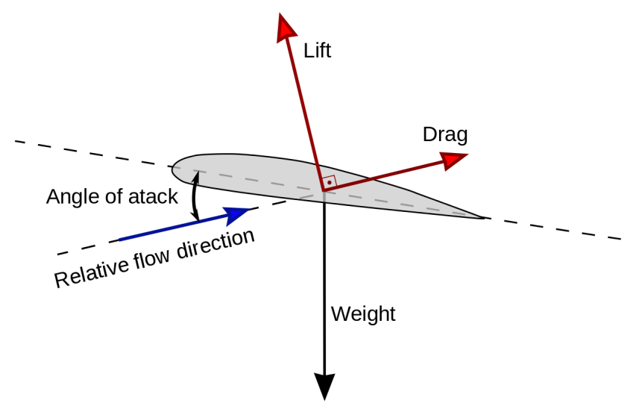
Lift to drag ratio
Blade “lift to drag ratio”(LDR)
Measure of aerodynamic efficiency
LDR is sensitive to:
Blade geometry, pitch and RPM
Turbulence
Relative wind speed
Angle of attack (AOA)
Optimal
Performance
rotation and wind
components
Stall
LDR
AOA

Slide 18
What affects Lift-to-Drag ratio?
At any instant:
RPM and pitch are constant
Local wind speed varies, causing AOA and LDR oscillation
This affects rotor performance
High AOA
Height
Low AOA
LDR
AOA
Wind speed

